Slide 1

编译实习
05. 从Piglet到Spiglet
黄 骏
jun.huang@pku.edu.cn
高能效计算与应用中心
北京大学信息科学与技术学院
理科五号楼515S

Slide 2
MiniJava Grammer
JavaCC
(JJTree)
Piglet
Grammar
SPiglet
Grammar
Kanga
Grammar
MIPS
Instruction Spec
自动生成
类型
检查
Piglet
代码
生成
SPiglet
代码
生成
Kanga
代码
生成
MIPS
代码
生成
词法
语法
分析
源
代
码
语法树
符号表
Piglet代码
SPiglet代码
Kanga代码
Mips 代码
后面一直会用
Piglet
解释器
SPiglet
解释器
Kanga
解释器
SPIM
(MIPS模拟器)

Slide 3
Spiglet 与 Piglet
Spiglet 与 Piglet 非常接近
主要区别包括：
(1) 没有“嵌套表达式”
(2) 语句中，只有 move 可以使用 表达式，
print 可以使用 简单表达式
其他语句均用 临时变量，为后续翻译提供方便
(临时变量与寄存器对应)
(3) 表达式只有四种类型
简单表达式 (SimpleEXP：临时变量、整数、标号)
调用 (Call)
内存分配 (HAllocate)
二元运算 (BinOp)
Spiglet代码由 Spiglet 解释器（spp.jar）解释执行
Notes:
Spiglet is a subset of Piglet.
The grammar for Spiglet differs from that of Piglet in two ways:
StmtExp is not an Exp in Spiglet, and
- in many places, Exp is replaced with SimpleExp or Temp.

Slide 4
Piglet代码语法
Goal ::= "MAIN" StmtList "END" ( Procedure )* <EOF>
StmtList ::= ( ( Label )? Stmt )*
Procedure ::= Label "[" IntegerLiteral "]" StmtExp
Stmt ::= NoOpStmt
| ErrorStmt
| CJumpStmt
| JumpStmt
| HStoreStmt
| HLoadStmt
| MoveStmt
| PrintStmt
NoOpStmt ::= "NOOP"
ErrorStmt ::= "ERROR"
CJumpStmt ::= "CJUMP" Exp Label
JumpStmt ::= "JUMP" Label
HStoreStmt ::= "HSTORE" Exp IntegerLiteral Exp
HLoadStmt ::= "HLOAD" Temp Exp IntegerLiteral
MoveStmt ::= "MOVE" Temp Exp
PrintStmt ::= "PRINT" Exp

Slide 5
Spiglet代码语法
Goal ::= "MAIN" StmtList "END" ( Procedure )* <EOF>
StmtList ::= ( ( Label )? Stmt )*
Procedure ::= Label "[" IntegerLiteral "]" StmtExp
Stmt ::= NoOpStmt
| ErrorStmt
| CJumpStmt
| JumpStmt
| HStoreStmt
| HLoadStmt
| MoveStmt
| PrintStmt
NoOpStmt ::= "NOOP"
ErrorStmt ::= "ERROR"
CJumpStmt ::= "CJUMP" Temp Label
JumpStmt ::= "JUMP" Label
HStoreStmt ::= "HSTORE" Temp IntegerLiteral Temp
HLoadStmt ::= "HLOAD" Temp Temp IntegerLiteral
MoveStmt ::= "MOVE" Temp Exp
PrintStmt ::= "PRINT" SimpleExp

Slide 6
求10的阶乘例子的对比
MAIN
PRINT CALL
BEGIN
MOVE TEMP 23
BEGIN
MOVE TEMP 24 HALLOCATE 4
MOVE TEMP 25 HALLOCATE 4
HSTORE TEMP 24 0 Fac_ComputeFac
HSTORE TEMP 25 0 TEMP 24
RETURN TEMP 25
END
HLOAD TEMP 21 TEMP 23 0
HLOAD TEMP 22 TEMP 21 0
RETURN TEMP 22
END (TEMP 23 10 )
END
Fac_ComputeFac [ 2 ]
BEGIN
CJUMP LT TEMP 1 1 L2
MOVE TEMP 20 1
JUMP L3
L2 MOVE TEMP 20 TIMES TEMP 1
CALL
BEGIN
MOVE TEMP 29 TEMP 0
HLOAD TEMP 27 TEMP 29 0
HLOAD TEMP 28 TEMP 27 0
RETURN TEMP 28
END
(TEMP 29 MINUS TEMP 1 1 )
L3 NOOP
RETURN TEMP 20
END
MAIN
MOVE TEMP 24 HALLOCATE 4
MOVE TEMP 25 HALLOCATE 4
MOVE TEMP 30 Fac_ComputeFac
HSTORE TEMP 24 0 TEMP 30
HSTORE TEMP 25 0 TEMP 24
MOVE TEMP 23 TEMP 25
HLOAD TEMP 21 TEMP 23 0
HLOAD TEMP 22 TEMP 21 0
MOVE TEMP 31 10
MOVE TEMP 32 CALL TEMP 22( TEMP 23 TEMP 31 )
PRINT TEMP 32
END
Fac_ComputeFac [2]
BEGIN
MOVE TEMP 33 1
MOVE TEMP 34 LT TEMP 1 TEMP 33
CJUMP TEMP 34 L2
MOVE TEMP 20 1
JUMP L3
L2 NOOP
MOVE TEMP 29 TEMP 0
HLOAD TEMP 27 TEMP 29 0
HLOAD TEMP 28 TEMP 27 0
MOVE TEMP 35 1
MOVE TEMP 36 MINUS TEMP 1 TEMP 35
MOVE TEMP 37 CALL TEMP 28( TEMP 29 TEMP 36 )
MOVE TEMP 38 TIMES TEMP 1 TEMP 37
MOVE TEMP 20 TEMP 38
L3 NOOP
RETURN TEMP 20
END

Slide 7
求10的阶乘例子的对比
MAIN
PRINT CALL
BEGIN
MOVE TEMP 23
BEGIN
MOVE TEMP 24 HALLOCATE 4
MOVE TEMP 25 HALLOCATE 4
HSTORE TEMP 24 0 Fac_ComputeFac
HSTORE TEMP 25 0 TEMP 24
RETURN TEMP 25
END
HLOAD TEMP 21 TEMP 23 0
HLOAD TEMP 22 TEMP 21 0
RETURN TEMP 22
END (TEMP 23 10 )
END
Fac_ComputeFac [ 2 ]
BEGIN
CJUMP LT TEMP 1 1 L2
MOVE TEMP 20 1
JUMP L3
L2 MOVE TEMP 20 TIMES TEMP 1
CALL
BEGIN
MOVE TEMP 29 TEMP 0
HLOAD TEMP 27 TEMP 29 0
HLOAD TEMP 28 TEMP 27 0
RETURN TEMP 28
END
(TEMP 29 MINUS TEMP 1 1 )
L3 NOOP
RETURN TEMP 20
END
MAIN
MOVE TEMP 24 HALLOCATE 4
MOVE TEMP 25 HALLOCATE 4
MOVE TEMP 30 Fac_ComputeFac
HSTORE TEMP 24 0 TEMP 30
HSTORE TEMP 25 0 TEMP 24
MOVE TEMP 23 TEMP 25
HLOAD TEMP 21 TEMP 23 0
HLOAD TEMP 22 TEMP 21 0
MOVE TEMP 31 10
MOVE TEMP 32 CALL TEMP 22( TEMP 23 TEMP 31 )
PRINT TEMP 32
END
Fac_ComputeFac [2]
BEGIN
MOVE TEMP 33 1
MOVE TEMP 34 LT TEMP 1 TEMP 33
CJUMP TEMP 34 L2
MOVE TEMP 20 1
JUMP L3
L2 NOOP
MOVE TEMP 29 TEMP 0
HLOAD TEMP 27 TEMP 29 0
HLOAD TEMP 28 TEMP 27 0
MOVE TEMP 35 1
MOVE TEMP 36 MINUS TEMP 1 TEMP 35
MOVE TEMP 37 CALL TEMP 28( TEMP 29 TEMP 36 )
MOVE TEMP 38 TIMES TEMP 1 TEMP 37
MOVE TEMP 20 TEMP 38
L3 NOOP
RETURN TEMP 20
END

Slide 8
求10的阶乘例子的对比
MAIN
PRINT CALL
BEGIN
MOVE TEMP 23
BEGIN
MOVE TEMP 24 HALLOCATE 4
MOVE TEMP 25 HALLOCATE 4
HSTORE TEMP 24 0 Fac_ComputeFac
HSTORE TEMP 25 0 TEMP 24
RETURN TEMP 25
END
HLOAD TEMP 21 TEMP 23 0
HLOAD TEMP 22 TEMP 21 0
RETURN TEMP 22
END (TEMP 23 10 )
END
Fac_ComputeFac [ 2 ]
BEGIN
CJUMP LT TEMP 1 1 L2
MOVE TEMP 20 1
JUMP L3
L2 MOVE TEMP 20 TIMES TEMP 1
CALL
BEGIN
MOVE TEMP 29 TEMP 0
HLOAD TEMP 27 TEMP 29 0
HLOAD TEMP 28 TEMP 27 0
RETURN TEMP 28
END
(TEMP 29 MINUS TEMP 1 1 )
L3 NOOP
RETURN TEMP 20
END
MAIN
MOVE TEMP 24 HALLOCATE 4
MOVE TEMP 25 HALLOCATE 4
MOVE TEMP 30 Fac_ComputeFac
HSTORE TEMP 24 0 TEMP 30
HSTORE TEMP 25 0 TEMP 24
MOVE TEMP 23 TEMP 25
HLOAD TEMP 21 TEMP 23 0
HLOAD TEMP 22 TEMP 21 0
MOVE TEMP 31 10
MOVE TEMP 32 CALL TEMP 22( TEMP 23 TEMP 31 )
PRINT TEMP 32
END
Fac_ComputeFac [2]
BEGIN
MOVE TEMP 33 1
MOVE TEMP 34 LT TEMP 1 TEMP 33
CJUMP TEMP 34 L2
MOVE TEMP 20 1
JUMP L3
L2 NOOP
MOVE TEMP 29 TEMP 0
HLOAD TEMP 27 TEMP 29 0
HLOAD TEMP 28 TEMP 27 0
MOVE TEMP 35 1
MOVE TEMP 36 MINUS TEMP 1 TEMP 35
MOVE TEMP 37 CALL TEMP 28( TEMP 29 TEMP 36 )
MOVE TEMP 38 TIMES TEMP 1 TEMP 37
MOVE TEMP 20 TEMP 38
L3 NOOP
RETURN TEMP 20
END

Slide 9
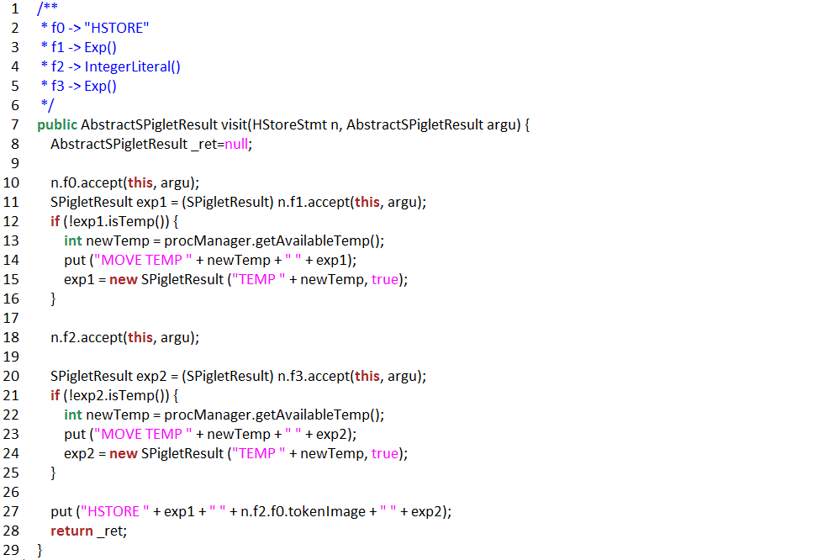
展开Exp1和Exp2

Slide 10
作业提交
目标
将任意给定的符合 “符合Piglet 规范的代码”正确地翻译为 “符合Spiglet 规范的代码”
主要是将 复合语句 （仅仅能在 Piglet 中出现的语句）翻译为 简单语句
ddl: 4.26 23:59
迟交减50%
代码打包发送至liutian@pku.edu.cn
邮件题目 [compiler20]HW3_学号

Slide 11
Thanks!

